Slide 1
Elevator Design
Colbin Hobbs 9/19/2022 Human Computer Interaction

Slide 2
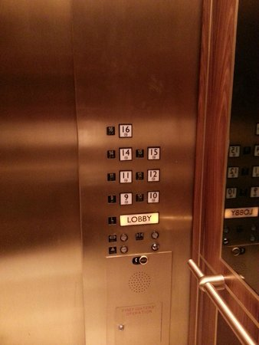
Mirage Hotel Elevator

Slide 3
Mirage Hotel Elevator
https://www.youtube.com/watch?v=kLF5nSrBq98

Slide 4
Some Flaws
What is going on with the numbers?
Separate elevator shafts for different floors
Remove congestion
The elevator call button is not labeled
Odd stack of buttons
But this may be necessary for the disabled
Inconsistent shape and size of buttons
Lower utility buttons are small and round

Slide 5
Some features
Disabled friendly
Buttons are low and handles are present
Obvious buttons
Especially LOBBY
Good size
LOBBY makes itself large while the other floor buttons do the same

Slide 6
Some Improvements
Make the floor buttons appear in a vertical column
Make the utility buttons the same size as the floor buttons
Add feedback to the utility buttons
Decrease the size of all buttons slightly
To help fit in the vertical column

Slide 7
Improved Sketch

Slide 8
A touch screen elevator?
I think that a touch screen elevator is bad for a few reasons
A higher level of maintenance if a problem arises
Software engineers may be needed
The elevator controls would be needlessly complex
Menus menus menus
Crashed / bugs in the controls could be devastating
At best annoy the passengers
At worst the elevator could be stuck closed. Panic ensues
The screen could break
Either from an angry passenger, neglect, or abuse

Slide 9
Before the demo
A touch screen would add uncertainty to a system that does not need more uncertainties.
“If it ain’t broke, don’t fix it”
About the demo
This design assumes physical buttons for emergency services and other utilities.

Slide 10
Some more creative input
Mirage hotel now has an identification system
No one can go up without a hotel card
This adds security in a place that needs it: Vegas
This could be used in more apartments / hotels
Vertical bars
Adds more places for passengers to grab
Intended to aid the disabled

